Slide 1
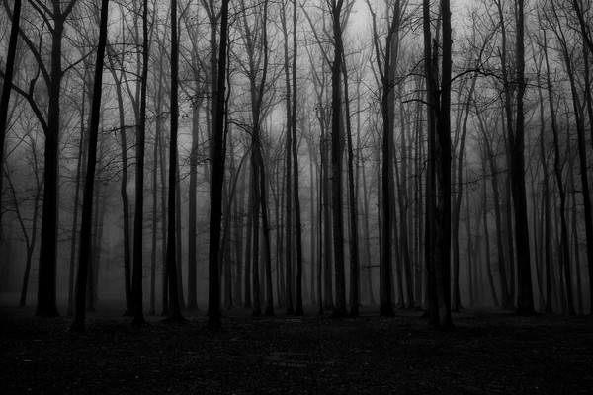
Global Suicide Trends & Analysis
Vaishali | Chandni | Gaurav | Jie | Javier | Duane | Liangliang | Wing
Working Together to Prevent Suicide

Slide 2



Did you know?
1 suicide every
40 seconds
(800K deaths per year)
15th
leading cause of death
15%
8%
** Statistics taken from WHO website.
Notes:
World Suicide Prevention Day (WSPD), on 10 September, is organized by the International Association for Suicide Prevention (IASP).
WHO has been co-sponsor of the day. The purpose of this day is to raise awareness around the globe that suicide can be prevented.
In past years, over 300 activities in around 70 countries were reported to IASP, including educational and commemorative events, press briefings and conferences, as well as Facebook and Twitter coverage.
https://www.who.int/mental_health/prevention/suicide/wspd/en/

Slide 3
Agenda
Data Source
Global trend
Find answers
Are high HDI and suicide rate correlated?
Rich countries have higher rate?
Did the suicide rate increase in the 2007-2008 recession?
Trends in
First world countries
Canada, UK, USA, France, and Ireland
in 2010-2015
External factors
Conclusions
Notes:
depressed

Slide 4

Data Source
Source : Kaggle
Format : CSV
Shape : 27,820 x 12
Categorical | Numerical
Country Year Sex Age Generation | Number of Suicides Suicides per 100k population GDP for year GDP per capita HDI
Limitations:
Data is available for only 93 countries
No data for populous countries like India, China.
HDI missing for half of the data

Slide 5
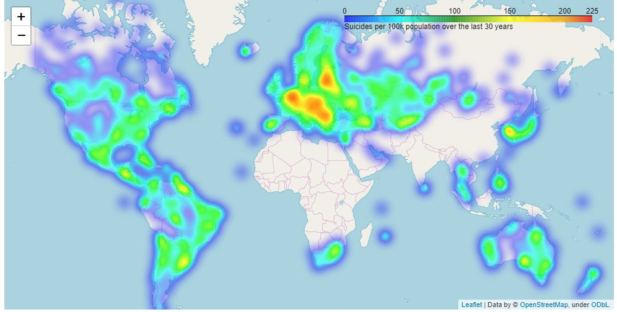
Global Trend – Worldwide
1
2
1
Southwestern European nations have highest suicidal rates (~199/100K) , while the rest of Europe are in line with the Americas (75 to 120 / 100K) .
2
Note the lack of data for Africa and parts of Asia
Notes:
impulsive

Slide 6
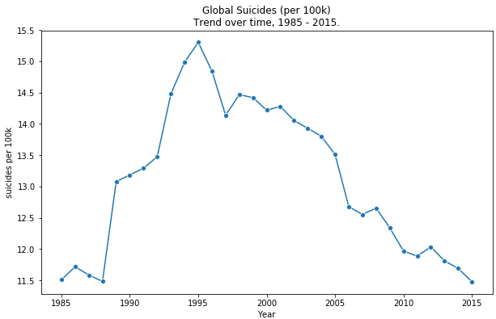
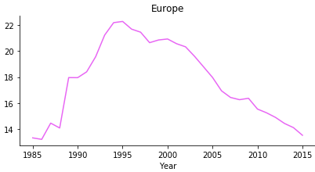
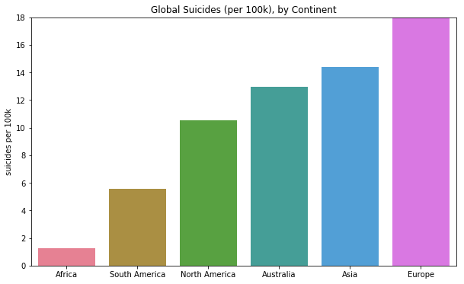
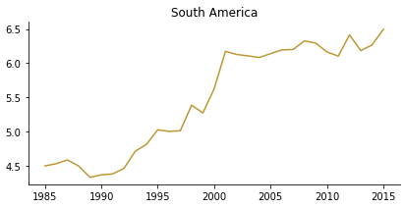
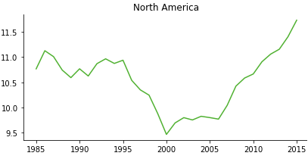
Global Trend – Continents
1
2
1
Peak in 1995: 15.3/100k
Europe steadily decreases since 1995
In 2015: suicide rate is 25% lower (11.5/100k) in comparison to peak.
2
3
4
The Americas are consistently increasing since 2000
3
European rate was the highest overall
4
Africa lacks sufficient data points to draw meaningful conclusions
Notes:
impulsive

Slide 7
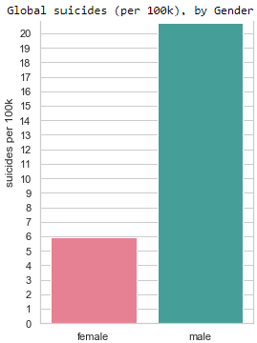
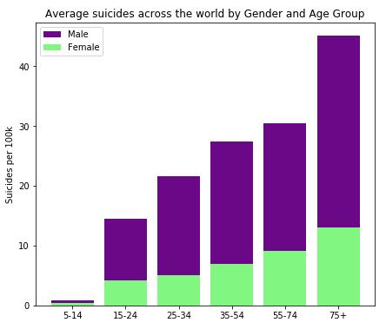
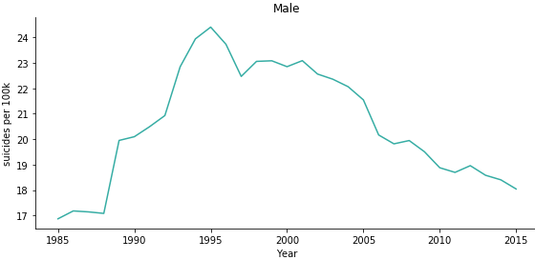
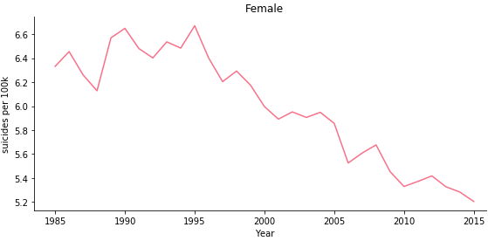
Global Trend – Gender Ratio
Men consistently have higher suicidal rates across all age groups and this increases with age.
Ratio 3.5 : 1 remained relatively flat since mid 1990’s
Notes:
crying out for help

Slide 8
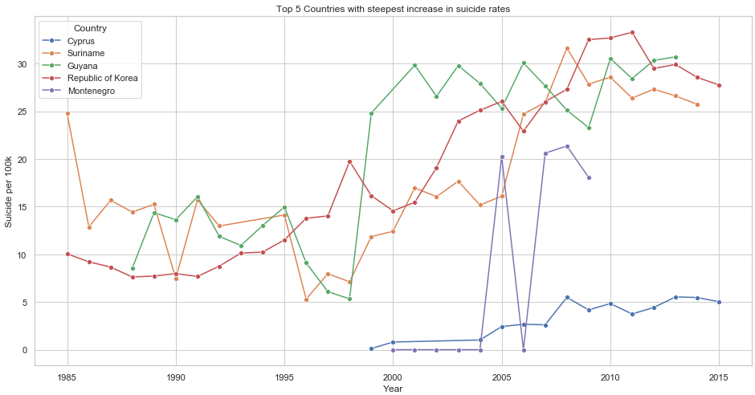
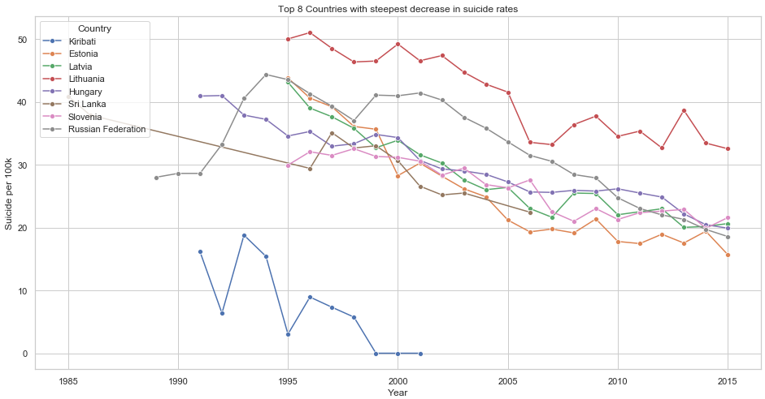
Global Trend – Countries with Highest Increase
Lithuania has the steepest increase of > 41 suicides/100k (per year)
Korea shows the most concerning trend - an increase in suicide of 0.931 people (per 100k, per year)
Guyana’s rate increased drastically from 5.3 to 24.8 during 1998-1999
Estonia shows the steepest decrease every year, ~1.31 less people/100k (per year)
Dropped from 43.8 to 15.7 per 100k (per year) during 1995-2015 - a 64% decrease
Notes:
crying out for help

Slide 9
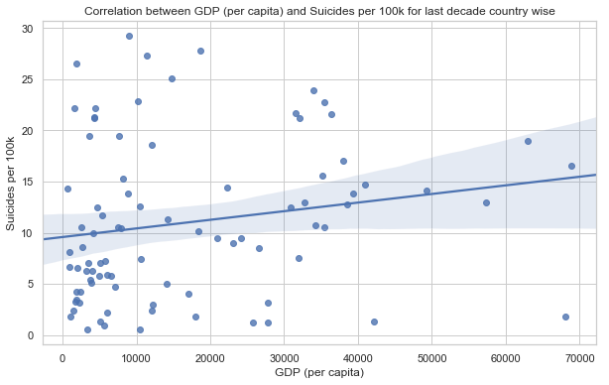
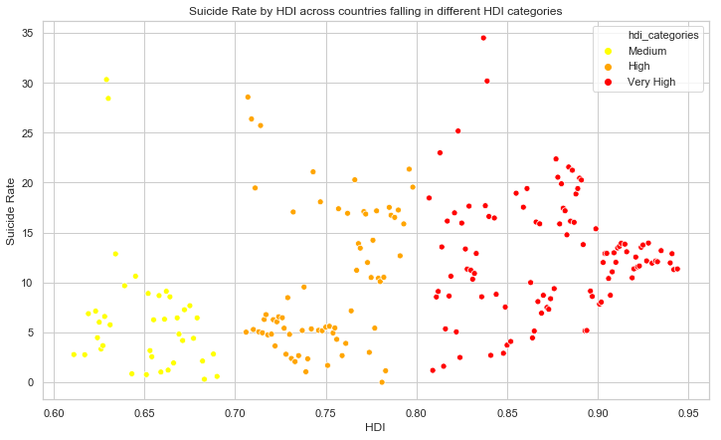
Find Answers
Do richer countries have higher rates of suicide?
Richer countries are associated with higher rates of suicide
Suicides = 8.7718 + 0.1115 * GDP
HDI vs. Suicide Rates between 2006 to 2015
HDI and suicide Rate exists a correlation of 0.43, indicating that there are higher suicidal rates for countries with high HDI
GDP & suicide rate have a weak negative correlation of -0.105 in the 2007-2008 recession.
Notes:
Made a mistake
-- 38countries report having a national strategy for suicide prevention

Slide 10
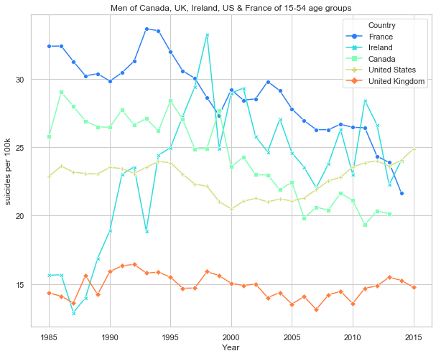
Trends in Developed Countries
Young to Middle-Aged Men from Canada, UK, US, Ireland and France
Canada shows downward trend. A decrease of ~35% from 1995-2006.
Ireland’s concerning. Went from ~14 (per 100k, per year) to 33 between 1988 and 1998 (an increase of ~135%)
US shows the most concerning upward trend
Notes:
have a philosophical desire to die

Slide 11
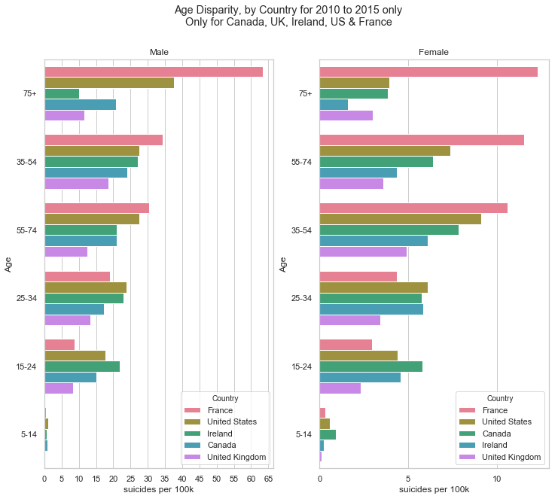
Trends in Developed Countries
2010 - 2015 for Canada, UK, US, Ireland and France
Suicide rate increases with age for France, and US (to a lesser extent)
35-54 at the highest risk in Canada, Ireland and the UK which follow closer to a gaussian distribution
In US, suicide rate for men and women continues to increase with age, but the female rate decreases in old age
Canada has the lowest suicide rate in every sex-age group
Notes:
have a philosophical desire to die

Slide 12
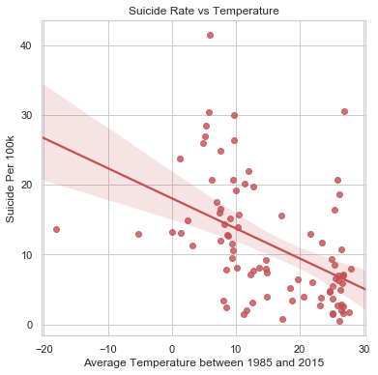
External Factor influencing Suicide Rate
Sun exposure is related to vitamin D linked with mental health and depression
Sun exposure is related to melatonin related to sleep quality
We integrated the data from Kaggle -Climate Change: Earth Surface Temperature Data with suicide data.
Negative correlation between average temperature of a country and its suicide rate
For the countries in our data, average temperature plays a role!

Slide 13
Conclusion
Suicide rates are decreasing globally
2/3 of countries show clear linear decreasing trends over time
On average, suicide rate increases with age for Americas, Asia & Europe, but not Africa
Weak positive relationship found between GDP (per capita) and suicide rate
Overrepresentation of men at every level of analysis- globally, at a continent and country level).
Globally, the male suicide rate is ~3.5x higher than female.
Average temperature of a country has a weak negative correlation with its suicide rate. However, this is not a universal factor.

Slide 14



Thank you
World Suicide Prevention Day
10 September, 2019
PREVENT SUICIDE: TEND THE HAND AND SAVE LIVES
Notes:
https://www.iasp.info/wspd2019/
Light a Candle near a Window at 8 PM to show your support for suicide prevention, to remember a lost loved one, and for the survivors of suicide.

